Slide 1
An introduction to Dynamic Linear Models
Mark Scheuerell
FISH 507 – Applied Time Series Analysis
31 January 2017

Slide 2
Dynamic linear models (DLMs)
DLMs are another form of MARSS model
But, their underlying structure is different from others we’ve examined
General idea is to allow for “evolution” of parameters over time
Can be univariate (y_{t}) or multivariate (y_{t}) in the response

Slide 3
References for DLMs
Petris G, Petrone S, Campagnoli P. 2009. Dynamic Linear Models with R. Springer, New York
Pole A, West M, Harrison J. 1994 Applied Bayesian Forecasting and Time Series Analysis. Chapman & Hall, New York
Cottingham KL, Rusak JA, Leavitt PR. 2000. Increased ecosystem variability and decreased predictability following fertilisation: evidence from paleolimnology. Ecol. Lett. 3: 340-348
Lamon EC, Carpenter SR, Stow CA. 1998. Forecasting PCB concentrations in Lake Michigan salmonids: a dynamic linear model approach. Ecol. Appl. 8: 659-668
Scheuerell MD, Williams JG. 2005. Forecasting climate-induced changes in the survival of Snake River spring/summer Chinook salmon. Fish. Ocean. 14: 448-457
Schindler DE, Rogers DE, Scheuerell MD, Abrey CA. 2005. Effects of changing climate on zooplankton and juvenile sockeye salmon growth in southwestern Alaska. Ecology 86: 198-209

Slide 4
Simple linear regression
Let’s begin with static (simple) linear regression with Gaussian errors
The idea is that the i^{th} observation is function of an intercept and explanatory variable(s)
Importantly, the index i has no explicit/implicit meaning—shuffling (y_{i}, F_{i}) pairs has no effect on parameter estimation or interpretation

Slide 5
Linear regression in matrix form
We can write the model in matrix notation
where
&

Slide 6
Dynamic linear model*
In a dynamic linear model, the regression parameters change over time, so we write
(static)
as
(dynamic)
Subscript t explicitly acknowledges implicit info in time ordering of data
Relationship between y and F is unique at every t
*univariate in the response

Slide 7
Constraining a DLM
Close examination of the DLM reveals an apparent complication for parameter estimation
With only 1 obs at each t, we could only hope to estimate 1 parameter (with no uncertainty)!
To address this, we will constrain the regression parameters to be dependent from t to t+1
In practice, we will typically make G time invariant
& often set G = I

Slide 8
DLM in matrix form*
State or “evolution” equation
Determines how parameters change over time
Observation equation
Relates explanatory variable(s) to the observation
*univariate in the response

Slide 9
DLM in MARSS notation
State or “evolution” equation
DLM:
MARSS:
Observation equation
DLM:
MARSS:

Slide 10
Contrast in covariate effects
Note: DLMs include covariate effects in obs eqn much differently than other forms of MARSS models
DLM:
DLM in MARSS:
Other MARSS:

Slide 11
Different forms of DLMs
The univariate regression model is just one example of a DLM—other forms include:
Stochastic “level” (intercept)
Stochastic “growth” (trend, bias)
Seasonal effects (fixed, harmonic)

Slide 12
The most simple univariate DLM
Stochastic “level” (intercept-only)
DLM
A random walk with observation error
MARSS

Slide 13
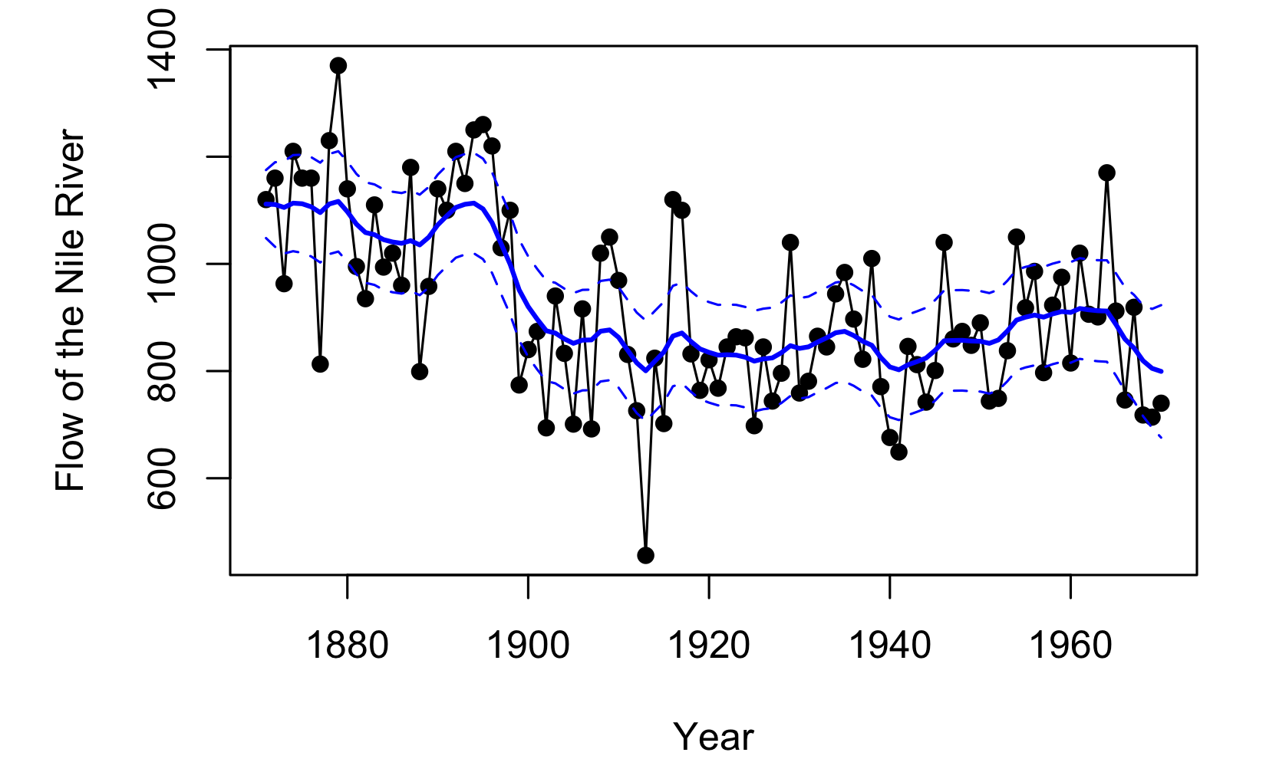
The most simple univariate DLM

Slide 14
The most simple multivariate DLM
Multiple observations of a single random walk

Slide 15
Another simple multivariate DLM
Multiple observations of multiple random walks

Slide 16
Univariate DLM for level & growth
Stochastic “level” with deterministic “growth”
DLM
Random walk with drift
MARSS

Slide 17
Univariate DLM for level & growth
Stochastic “level” with stochastic “growth”
Level:
Growth:
Level:
Growth:
Level:
Growth:

Slide 18
Univariate DLM for level & growth
Stochastic “level” with stochastic “growth”
Level:
Growth:
DLM:
MARSS:

Slide 19
Univariate DLM for level & trend
Observation eqn for stochastic “level” and “growth”
Obs:
Define:
DLM:
MARSS:

Slide 20
Univariate DLM for regression
Stochastic “intercept” with stochastic “slope”
Intercept:
Slope:
DLM:
MARSS:

Slide 21
Univariate DLM for regression
Observation eqn for stochastic “intercept” and “slope”
Obs:
Define:
DLM:
MARSS:

Slide 22
Forecasting with univariate DLM
DLMs are often used in a forecasting context where we are interested in a prediction at time t conditioned on data up through time t-1
Beginning with the distribution of θ at time t-1 conditioned on data through time t-1:
Then, the predictive distribution for θ_{t} given y_{1:t-1} is:
And, the one-step ahead predictive distribution for y_{t} given y_{1:t-1} is:

Slide 23
Forecasting with univariate DLM
Don’t worry! MARSS will make this easy for you.
DLMs are often used in a forecasting context where we are interested in a prediction at time t conditioned on data up through time t-1
Beginning with the distribution of θ at time t-1 conditioned on data through time t-1:
Then, the predictive distribution for θ_{t} given y_{1:t-1} is:
And, the one-step ahead predictive distribution for y_{t} given y_{1:t-1} is:

Slide 24
Diagnostics for DLMs
Just as we have seen for other models, diagnostics are an important part of fitting DLMs
When forecasting, we are often interested in the forecast errors (e_{t} = observed_{t} - forecast_{t})
In particular, DLMs have the following assumptions:
1)
2)
We can check (1) with a QQ-plot and (2) with an ACF

Slide 25
Multivariate DLM
Here we will examine multiple responses at once, so we need a multivariate DLM
First, the obs eqn
becomes

Slide 26
Multivariate DLM – obs eqn
=

Slide 27
Multivariate DLM – obs eqn
=
+

Slide 28
Multivariate DLM – obs eqn

Slide 29
Multivariate DLM – evolution eqn
The evolution eqn
becomes

Slide 30
Multivariate DLM – evolution eqn
=
+

Slide 31
Multivariate DLM – evolution eqn

Slide 32
Multivariate DLM – evolution eqn
For k < n “groups”

Slide 33
Topics for lab
Fitting univariate DLM regression model with MARSS
Examining “evolution” of parameters
Examining model fit
Model diagnostics

